Slide 1
DATA 300
Topic 6: Tree-based methods

Slide 2
Agenda
Decision trees
Overview
Regression trees
Tree pruning
Classification trees
Tree-based methods

Slide 3
Assume we have the following dataset..
 | Qualified/Not qualified | Job history/ reference rating | Interview rating | Interpersonal skill
Candidate 1
#2
…

Slide 4
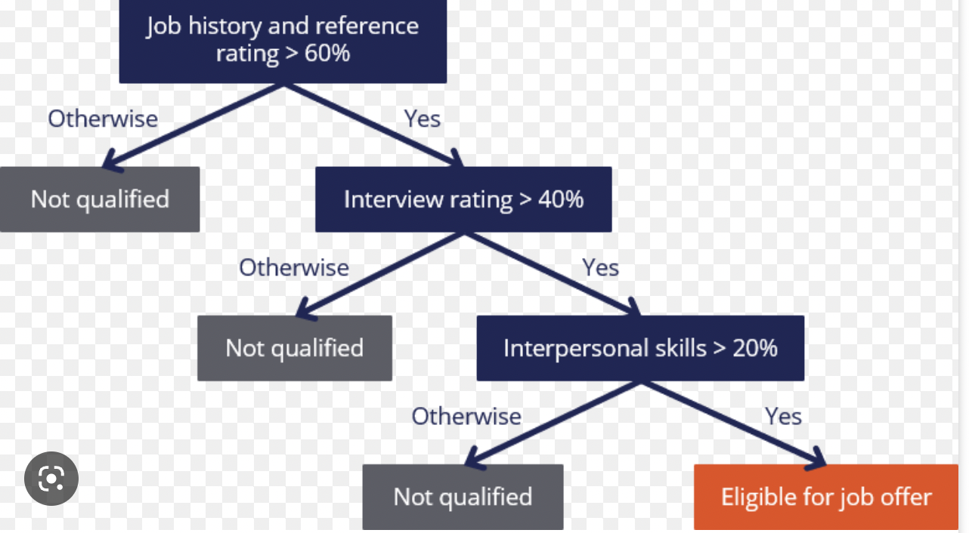
Overview of decision tree

Slide 5

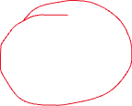

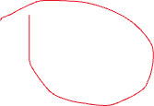
“Regions” in decision trees
The circled ones are called terminal nodes, other nodes are called internal nodes, and the nodes are called being connected by branches.

Slide 6
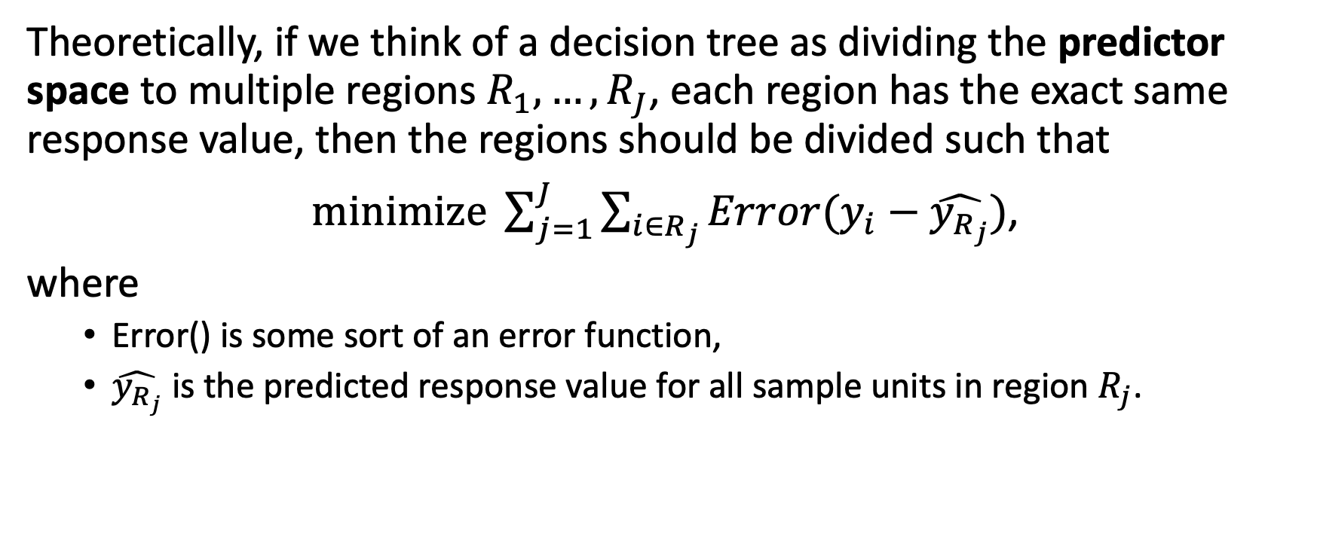
Overview of decision tree
Theoretically, if we think of a decision tree as dividing the predictor space to multiple regions $R_{1},…,R_{J}$, each region has the exact same response value, then the regions should be divided such that
$\operatorname{minimize}{\sum_{j=1}^{J}{\sum_{i∈R_{j}}{Error(y_{i}−\hat{y_{R_{j}}})}}}$,
where
Error() is some sort of an error function,
$\hat{y_{R_{j}}}$ is the predicted response value for all sample units in region $R_{j}$.

Slide 7
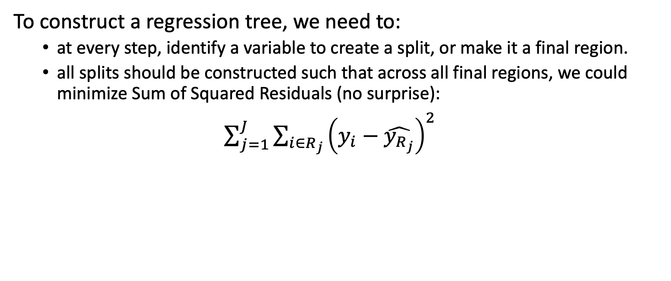
Regression tree
To construct a regression tree, we need to:
at every step, identify a variable to create a split, or make it a final region.
all splits should be constructed such that across all final regions, we could minimize Sum of Squared Residuals (no surprise):
$\sum_{j=1}^{J}{\sum_{i∈R_{j}}{{\left(y_{i}−\hat{y_{R_{j}}}\right)}^{2}}}$

Slide 8
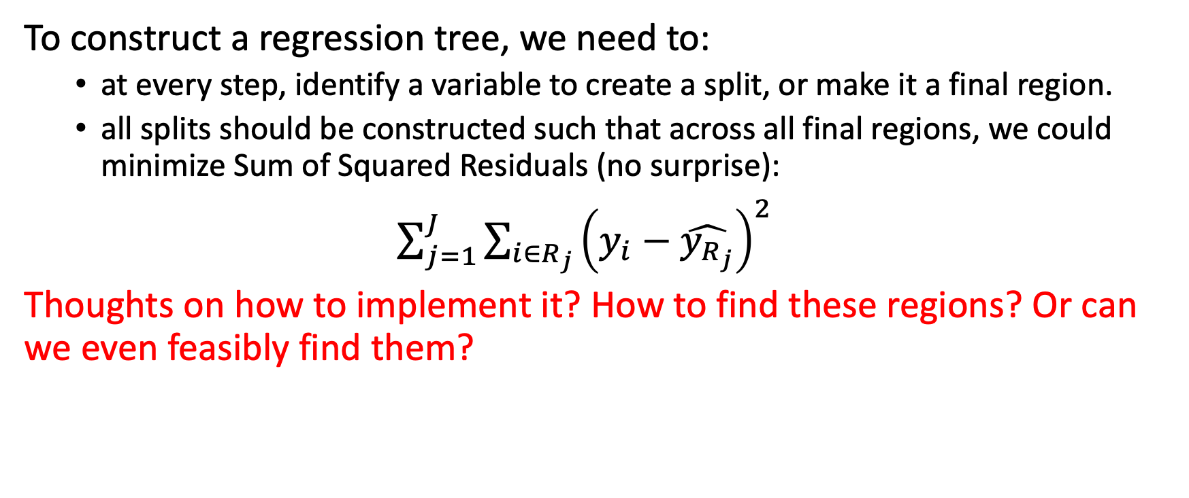
Regression tree
To construct a regression tree, we need to:
at every step, identify a variable to create a split, or make it a final region.
all splits should be constructed such that across all final regions, we could minimize Sum of Squared Residuals (no surprise):
$\sum_{j=1}^{J}{\sum_{i∈R_{j}}{{\left(y_{i}−\hat{y_{R_{j}}}\right)}^{2}}}$
Thoughts on how to implement it? How to find these regions? Or can we even feasibly find them?

Slide 9
Search algorithm for decision trees
It is computationally infeasible to find such an optimal partition. Instead, we use a top-down, greedy approach:
Top-down: start at the top
Greedy: every split is the best split at this step, but may NOT be the best in the long term.

Slide 10

Search algorithm for decision trees
It is computationally infeasible to find such an optimal partition. Instead, we use a top-down, greedy approach:
Top-down: start at the top
Greedy: every split is the best split at this step, but may NOT be the best in the long term.
In other words, at every step when deciding which predictor to use for splitting (or call it a final region), the split is only constructed in a way such that the RSS at this split is minimized:

Slide 11
Search algorithm for decision trees
It is computationally infeasible to find such an optimal partition. Instead, we use a top-down, greedy approach:
Top-down: start at the top
Greedy: every split is determined such that the RSS at this split is minimized.
This is also known as recursive binary splitting. At every step, we find a predictor and the cutpoint to split the data, until a user-defined stopping criteria has reached. E.g., all regions contain less than five observations.

Slide 12

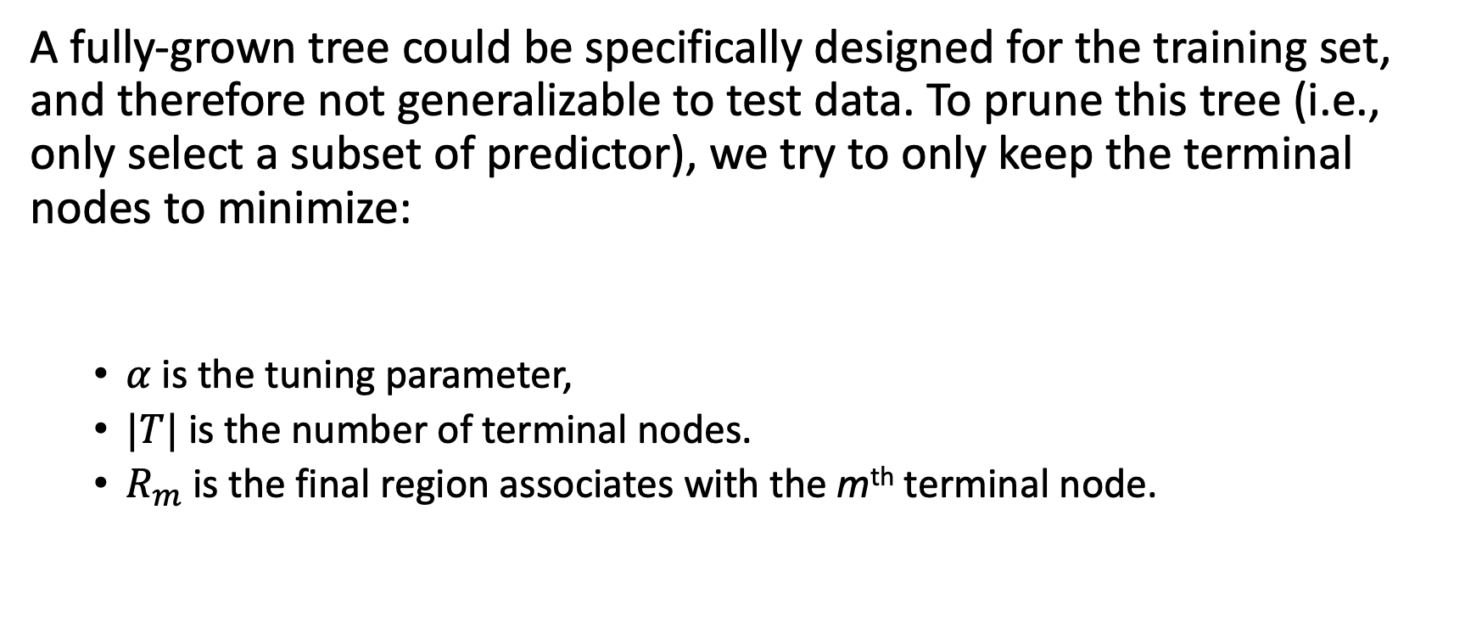
Variable selection in decision tree: Tree pruning
A fully-grown tree could be specifically designed for the training set, and therefore not generalizable to test data. To prune this tree (i.e., only select a subset of predictor), we try to only keep the terminal nodes to minimize:
$α$ is the tuning parameter,
$|T|$ is the number of terminal nodes.
$R_{m}$ is the final region associates with the m^{th} terminal node.

Slide 13
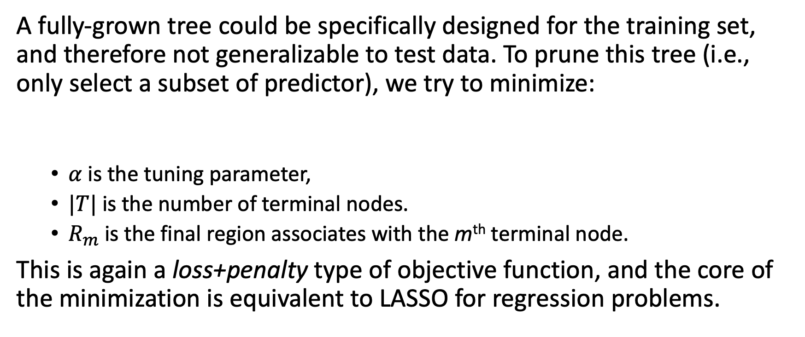
Variable selection in decision tree: Tree pruning
A fully-grown tree could be specifically designed for the training set, and therefore not generalizable to test data. To prune this tree (i.e., only select a subset of predictor), we try to minimize:
$α$ is the tuning parameter,
$|T|$ is the number of terminal nodes.
$R_{m}$ is the final region associates with the m^{th} terminal node.
This is again a loss+penalty type of objective function, and the core of the minimization is equivalent to LASSO for regression problems.

Slide 14
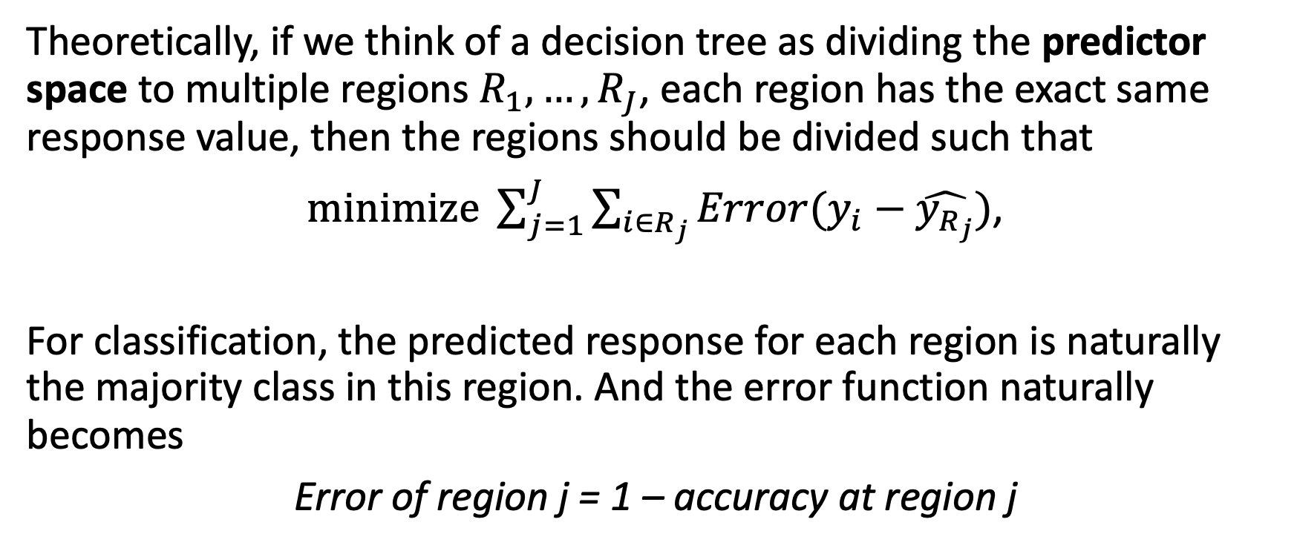
Classification trees
Theoretically, if we think of a decision tree as dividing the predictor space to multiple regions $R_{1},…,R_{J}$, each region has the exact same response value, then the regions should be divided such that
$\operatorname{minimize}{\sum_{j=1}^{J}{\sum_{i∈R_{j}}{Error(y_{i}−\hat{y_{R_{j}}})}}}$,
For classification, the predicted response for each region is naturally the majority class in this region. And the error function naturally becomes
Error of region j = 1 – accuracy at region j

Slide 15
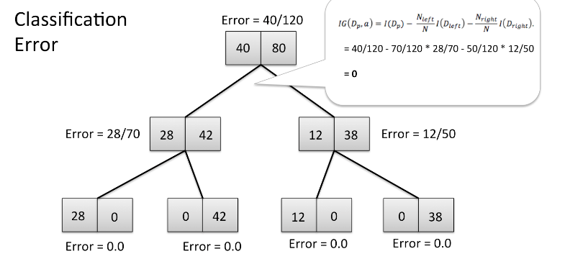
Alternative approaches to error rate
However, in practice, error rate is NOT a preferred measure in decision trees. Consider the following tree:
If this tree was successfully built, it would have been a perfect tree with error equal to 0 at all terminal nodes.

Slide 16


Alternative approaches to error rate
However, in practice, error rate is NOT a preferred measure in decision trees. Consider the following tree:
But.. if our goal is to minimize error at each split, then the split at the second layer won’t happen because 28/70 is higher than 40/120. In other words, this split would cause an increasing error, and thus won’t be chosen.

Slide 17

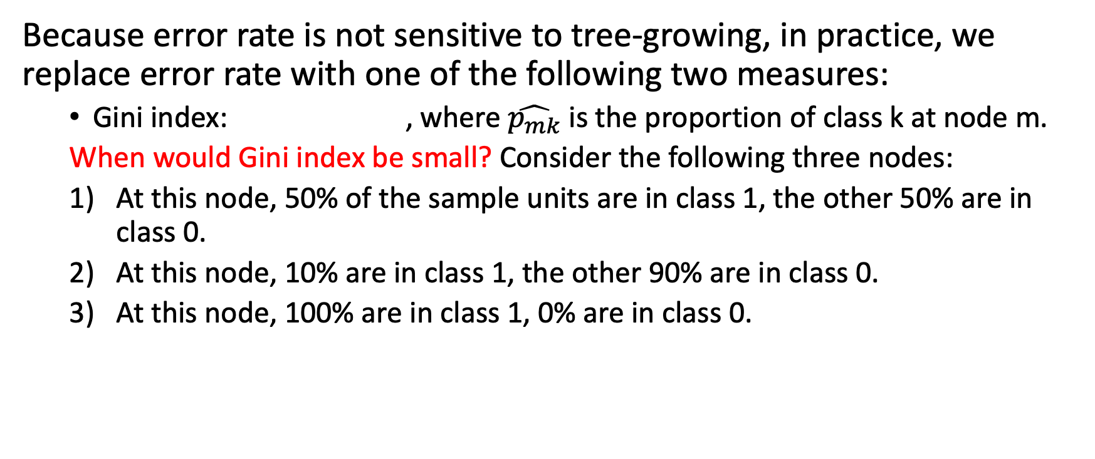
Alternative approaches to error rate
Because error rate is not sensitive to tree-growing, in practice, we replace error rate with one of the following two measures:
Gini index: , where $\hat{p_{mk}}$ is the proportion of class k at node m.
When would Gini index be small? Consider the following three nodes:
At this node, 50% of the sample units are in class 1, the other 50% are in class 0.
At this node, 10% are in class 1, the other 90% are in class 0.
At this node, 100% are in class 1, 0% are in class 0.

Slide 18
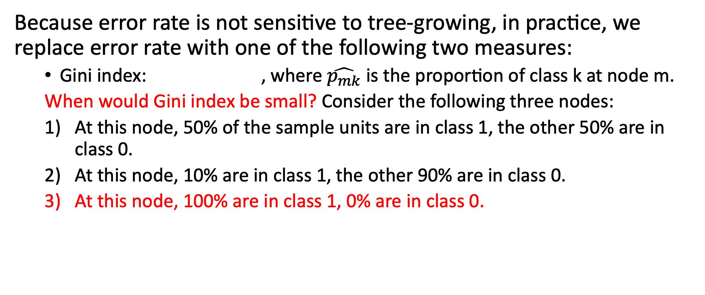
Alternative approaches to error rate
Because error rate is not sensitive to tree-growing, in practice, we replace error rate with one of the following two measures:
Gini index: , where $\hat{p_{mk}}$ is the proportion of class k at node m.
When would Gini index be small? Consider the following three nodes:
At this node, 50% of the sample units are in class 1, the other 50% are in class 0.
At this node, 10% are in class 1, the other 90% are in class 0.
At this node, 100% are in class 1, 0% are in class 0.

Slide 19

Alternative approaches to error rate
Because error rate is not sensitive to tree-growing, in practice, we replace error rate with one of the following two measures:
Gini index: , where $\hat{p_{mk}}$ is the proportion of class k at node m. To minimize Gini index, we are forcing each node has a strongly dominating class k. Gini index is thus considered as a measure of impurity.

Slide 20

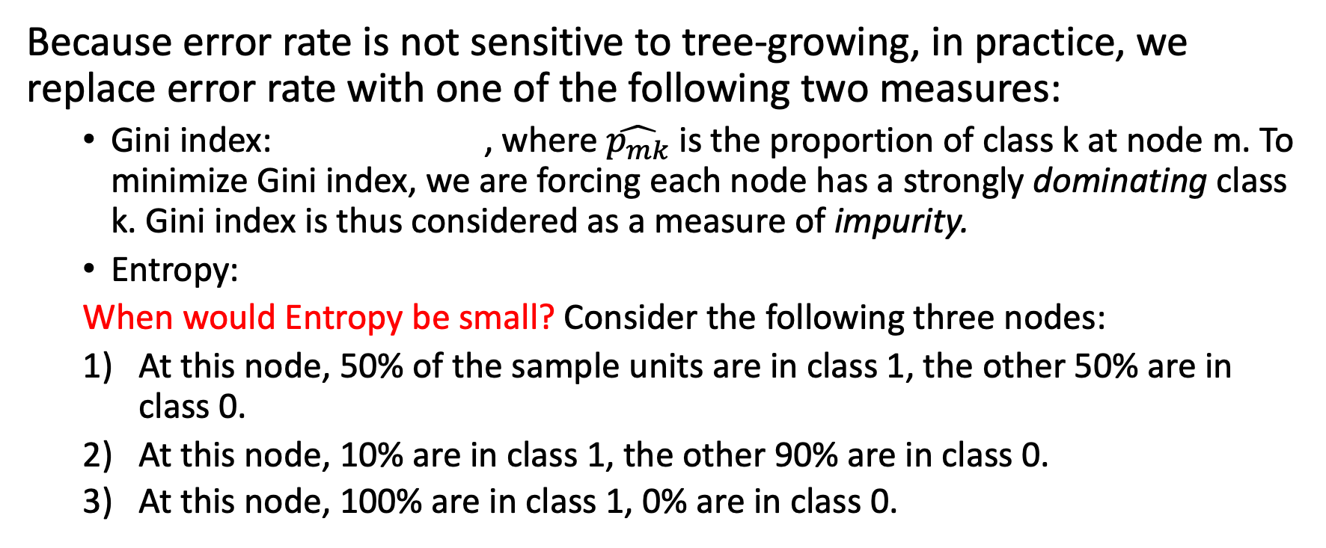
Alternative approaches to error rate
Because error rate is not sensitive to tree-growing, in practice, we replace error rate with one of the following two measures:
Gini index: , where $\hat{p_{mk}}$ is the proportion of class k at node m. To minimize Gini index, we are forcing each node has a strongly dominating class k. Gini index is thus considered as a measure of impurity.
Entropy:
When would Entropy be small? Consider the following three nodes:
At this node, 50% of the sample units are in class 1, the other 50% are in class 0.
At this node, 10% are in class 1, the other 90% are in class 0.
At this node, 100% are in class 1, 0% are in class 0.

Slide 21
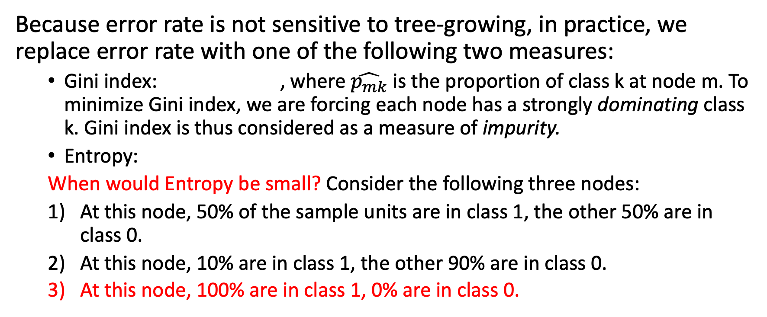
Alternative approaches to error rate
Because error rate is not sensitive to tree-growing, in practice, we replace error rate with one of the following two measures:
Gini index: , where $\hat{p_{mk}}$ is the proportion of class k at node m. To minimize Gini index, we are forcing each node has a strongly dominating class k. Gini index is thus considered as a measure of impurity.
Entropy:
When would Entropy be small? Consider the following three nodes:
At this node, 50% of the sample units are in class 1, the other 50% are in class 0.
At this node, 10% are in class 1, the other 90% are in class 0.
At this node, 100% are in class 1, 0% are in class 0.

Slide 22
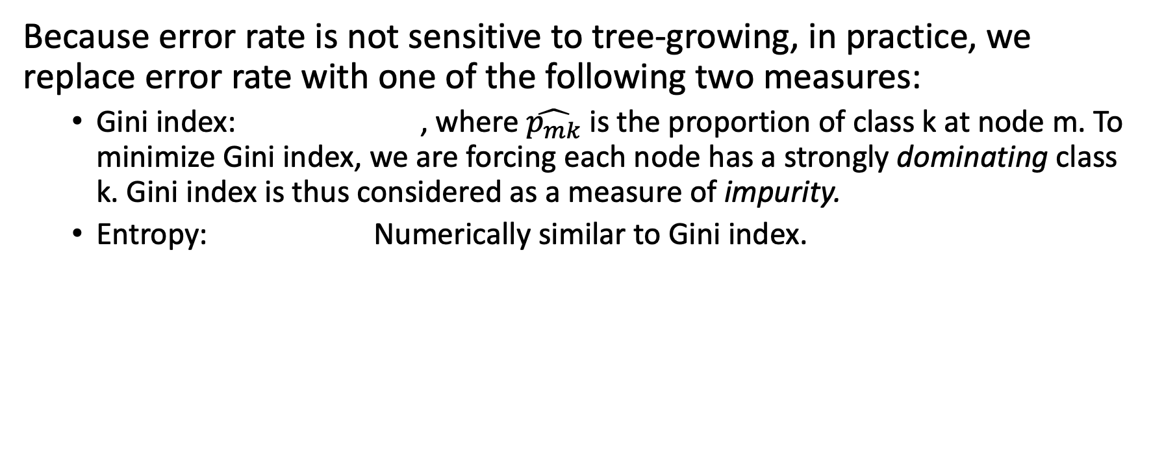
Alternative approaches to error rate
Because error rate is not sensitive to tree-growing, in practice, we replace error rate with one of the following two measures:
Gini index: , where $\hat{p_{mk}}$ is the proportion of class k at node m. To minimize Gini index, we are forcing each node has a strongly dominating class k. Gini index is thus considered as a measure of impurity.
Entropy: Numerically similar to Gini index.

Slide 23
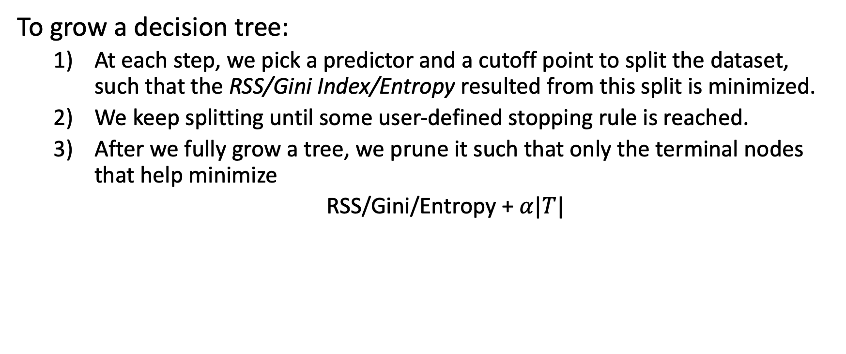
Summary of decision trees
To grow a decision tree:
At each step, we pick a predictor and a cutoff point to split the dataset, such that the RSS/Gini Index/Entropy resulted from this split is minimized.
We keep splitting until some user-defined stopping rule is reached.
After we fully grow a tree, we prune it such that only the terminal nodes that help minimize
RSS/Gini/Entropy + $α|T|$

Slide 24
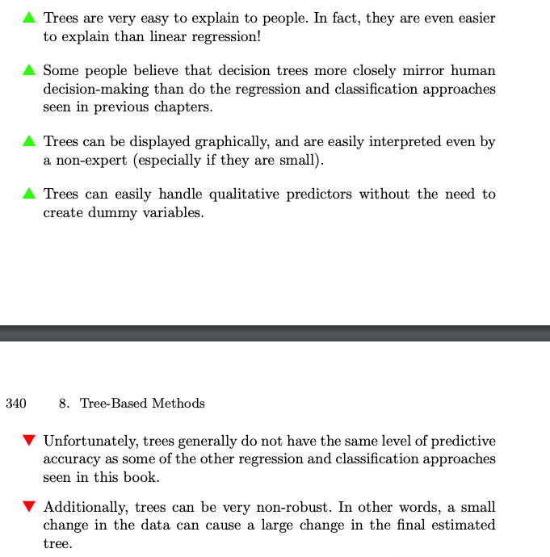
Pros and cons of decision trees

